Slide 1

PERSONAL PORTFOLIO WEBSITE
A Responsive Web Development Project by Sachin Lambe
Computer Engineering (2nd Year)
NMIET, Pune
Web Development Lab Project

Slide 2
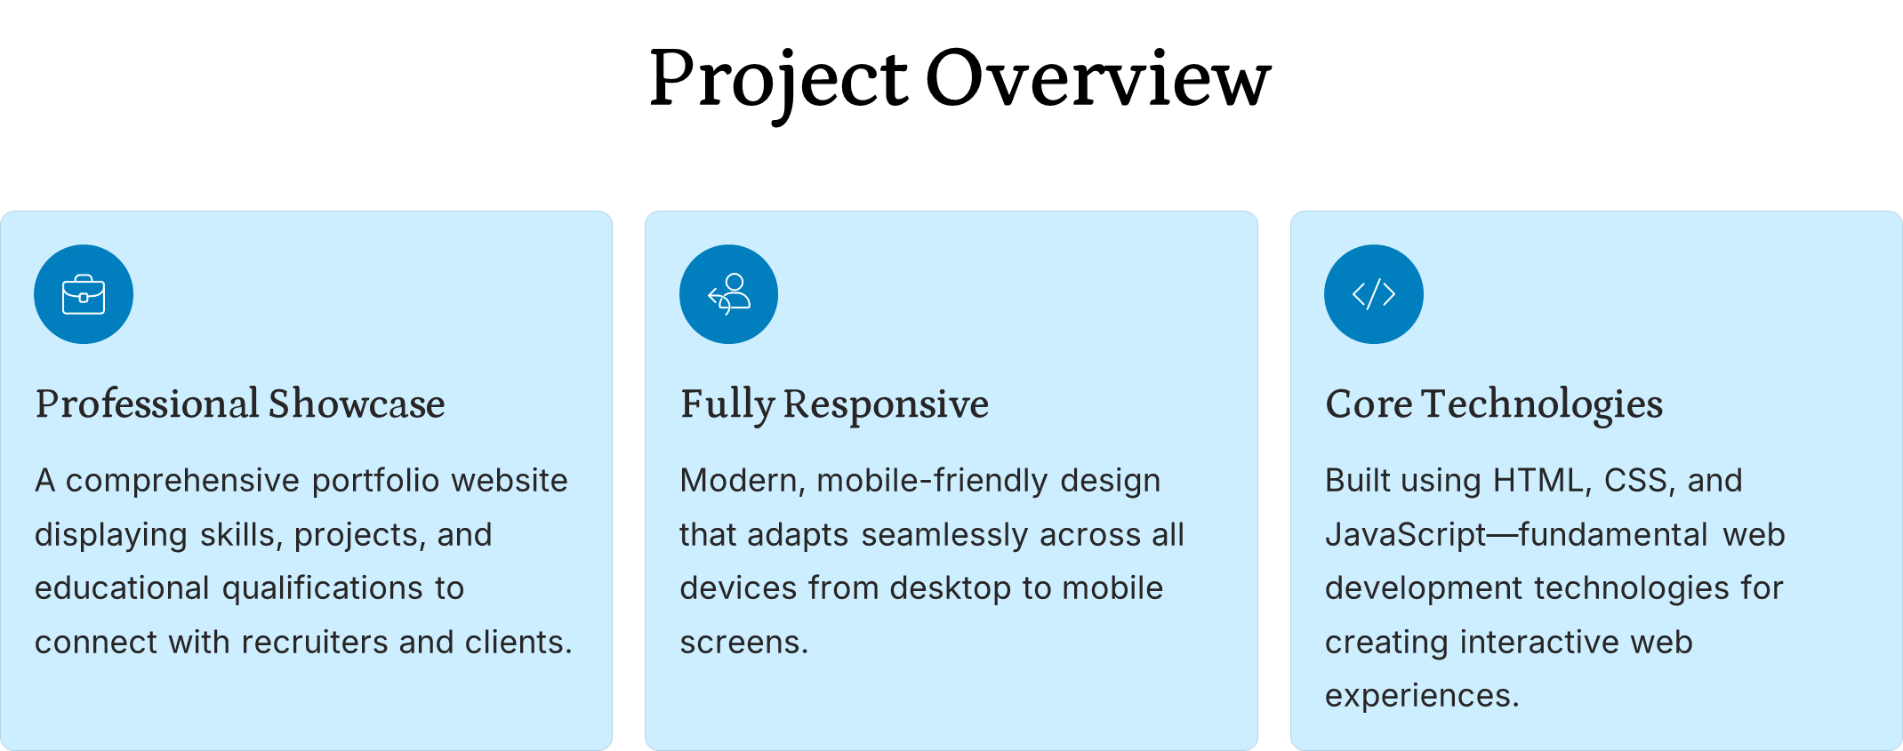

Slide 3
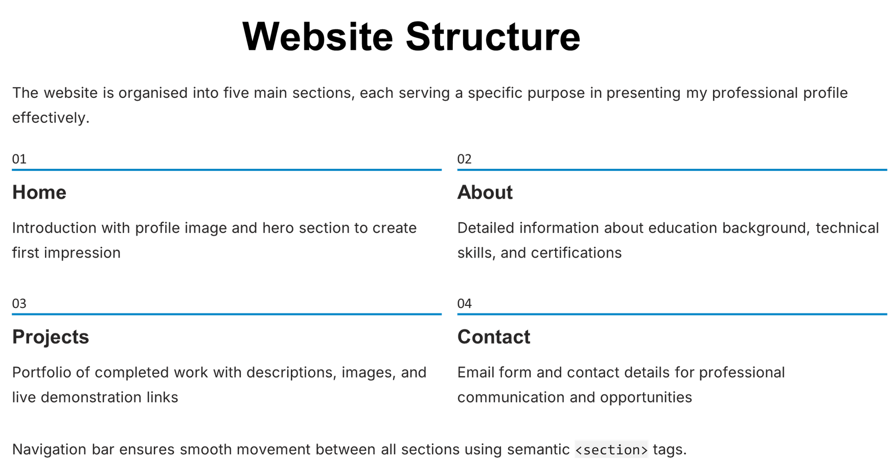

Slide 4
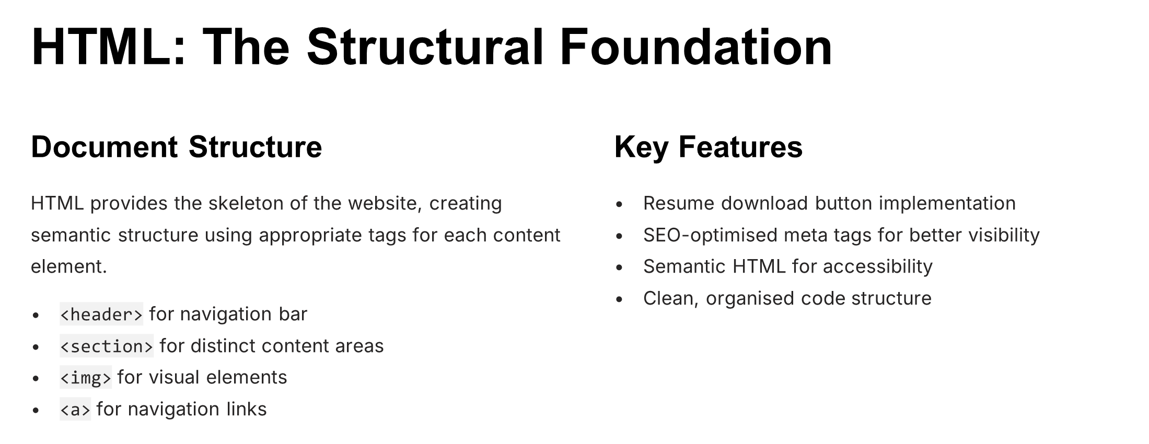

Slide 5
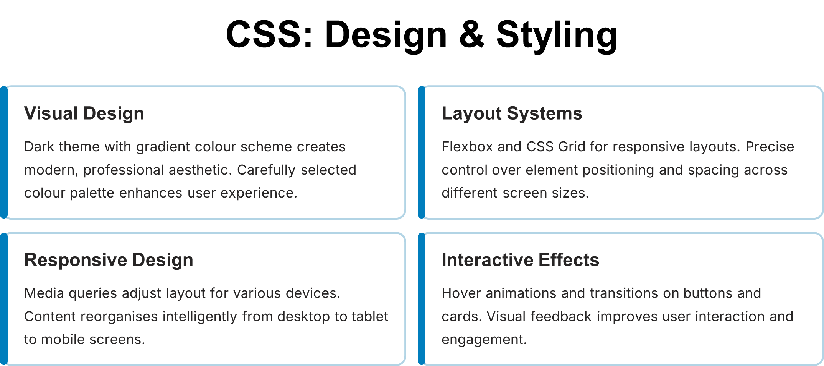

Slide 6
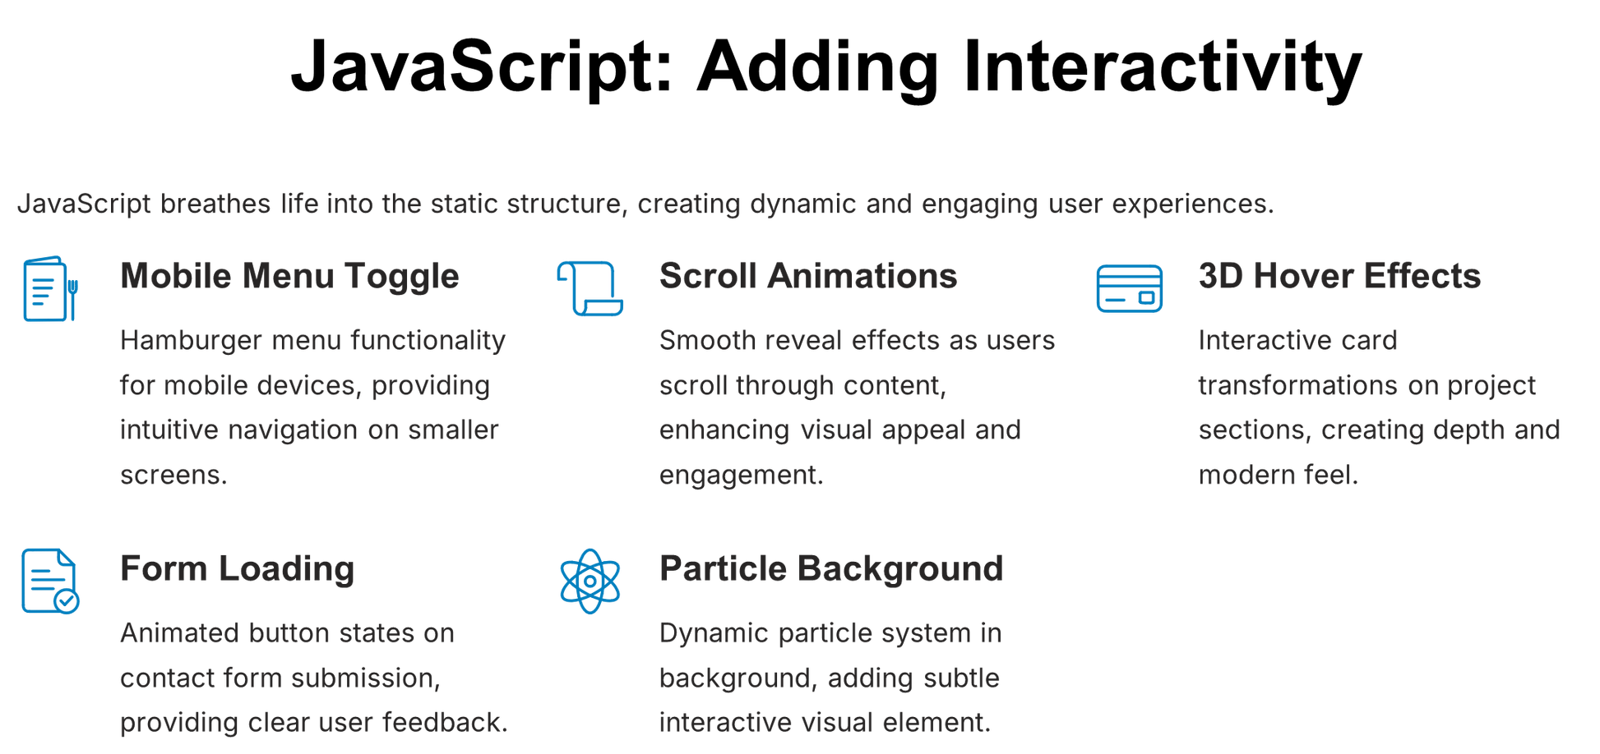

Slide 7
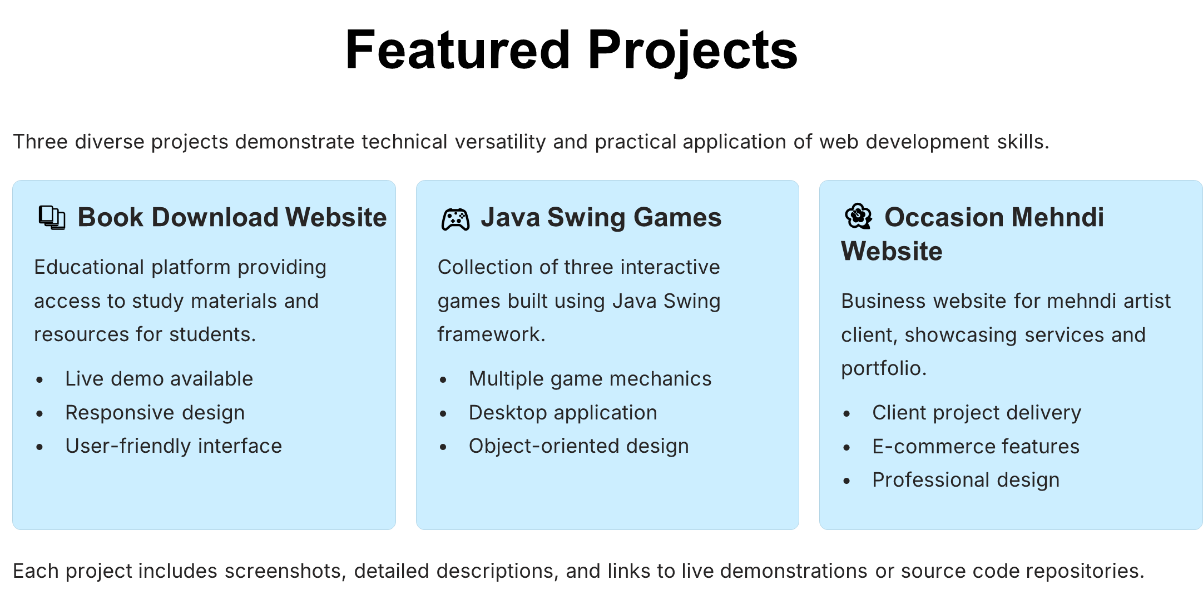

Slide 8
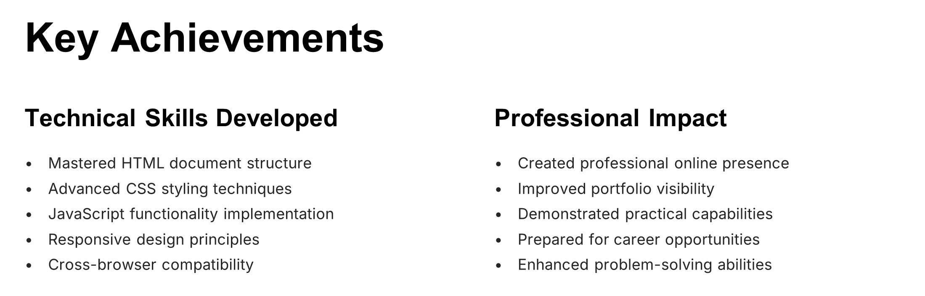

Slide 9
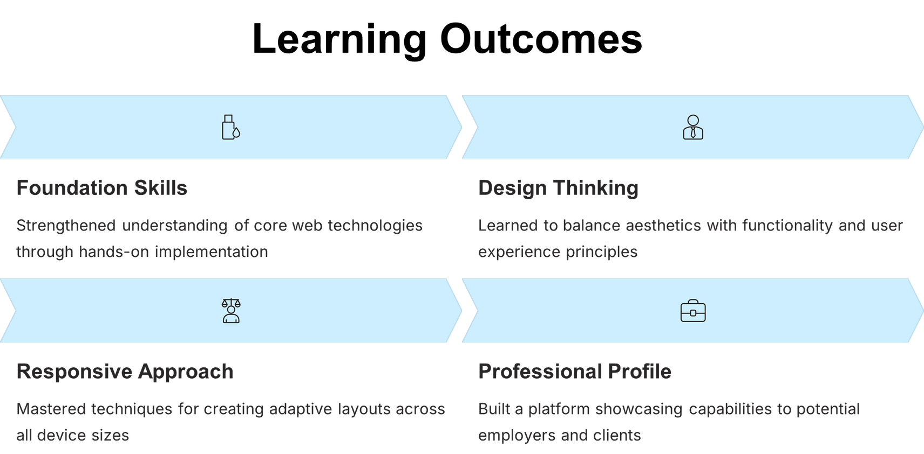

Slide 10
